Slide 1

MICRO-CREDIT DEFAULTER MODEL
BY
K. Naveen Varma
By
K.Naveen Varma

Slide 2
Introduction Of Project:
A Microfinance Institution (MFI) is an organization that offers financial services to low income populations. MFS becomes very useful when targeting especially the unbanked poor families living in remote areas with not much sources of income. The Microfinance services (MFS) provided by MFI are Group Loans, Agricultural Loans, Individual Business Loans and so on.
Many microfinance institutions (MFI), experts and donors are supporting the idea of using mobile financial services (MFS) which they feel are more convenient and efficient, and cost saving, than the traditional high-touch model used since long for the purpose of delivering microfinance services. Though, the MFI industry is primarily focusing on low income families and are very useful in such areas, the implementation of MFS has been uneven with both significant challenges and successes.
Today, microfinance is widely accepted as a poverty-reduction tool, representing $70 billion in outstanding loans and a global outreach of 200 million clients.

Slide 3
Problem Statement:
Build a model which can be used to predict in terms of a probability for each loan transaction, whether the customer will be paying back the loaned amount within 5 days of insurance of loan. In this case, Label ‘1’ indicates that the loan has been payed i.e. Non- defaulter, while, Label ‘0’ indicates that the loan has not been payed i.e. defaulter.

Slide 4
Data Analysis:
The Dataset Contains a Data of 209593 entries each having 37 variables, in which some are numerical Data and some are Categorical Data
Check the info of the data using the info() function
From the above function I analyze the dataset having float varaibles -21 int-13 and object-3 so total of 37 variables.
Next Step is EDA……..(Exploratory Data Analysis)

Slide 5
Exploratory Data Analysis:
In EDA we need to Pre-process the Data and Visualization:
Steps include in Pre-Processing Data are
1)Data Cleaning: - Removing Outliers, Skewness and imputing Missing Values.
2)Data Transformation: - like Normalization by applying normalization we can improve the accuracy and efficiency of the models. And also reduce the errors.
3)Data Reduction: By Reducing the no of features by Feature Selection Process, PCA And VIF
1.Data Cleaning: As a Part of EDA we need to do Data cleaning so firstly we need to check any null values in our data, From the below image shows we don’t have any null values, so no need to impute any data

Slide 6
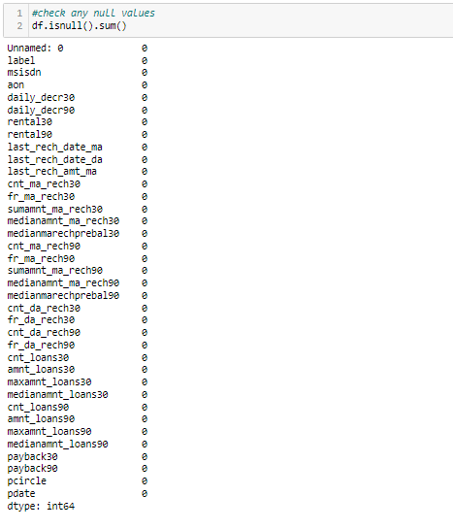

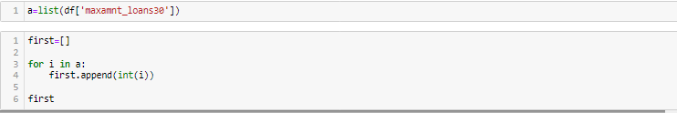
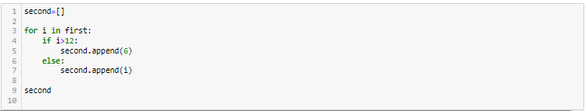
First Step of Data Cleaning is Checking Any null Values in our Data set
For this we used the function
As per the above formula my data-set is clean and from the Data I removed some columns which are not useful for my model
Replace some unwanted amount into a particular amount to make it understandable
For the remai

Slide 7
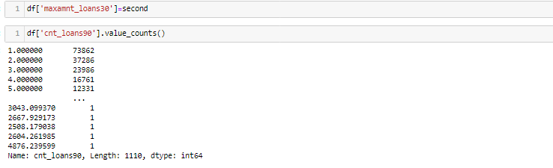
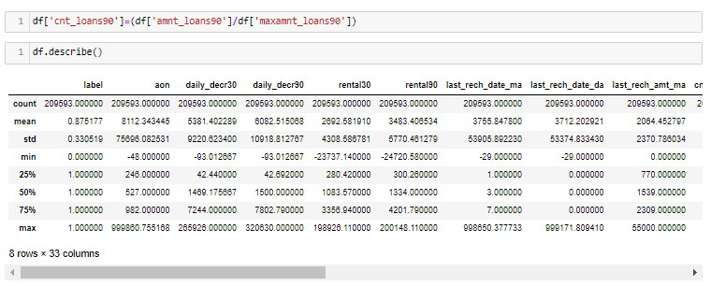
From the above describe function we know each variable percentiles, from observing we understand 75% to 100% there is a lot of difference so there are so many outliers.
By checking correlation we understood little bit more about variables using heatmap function

Slide 8
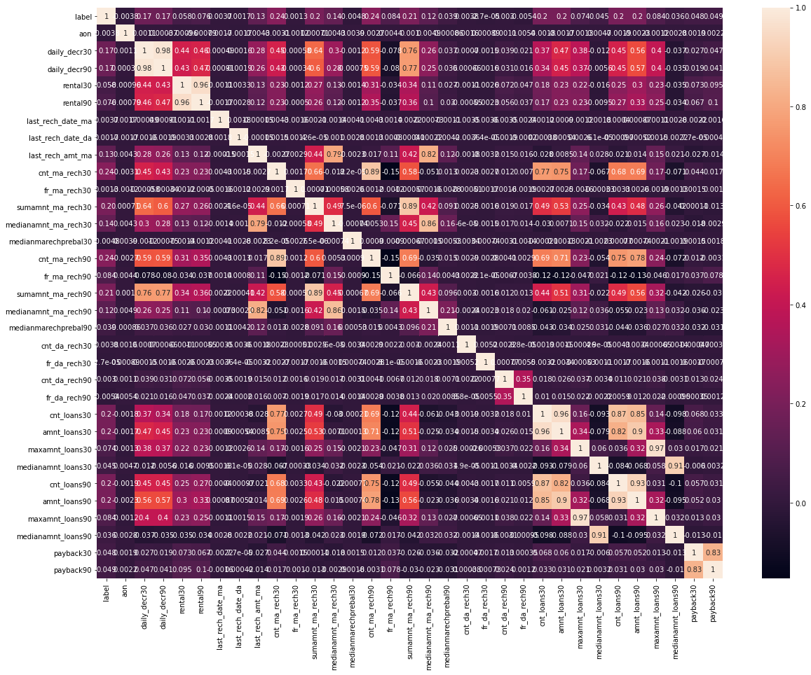
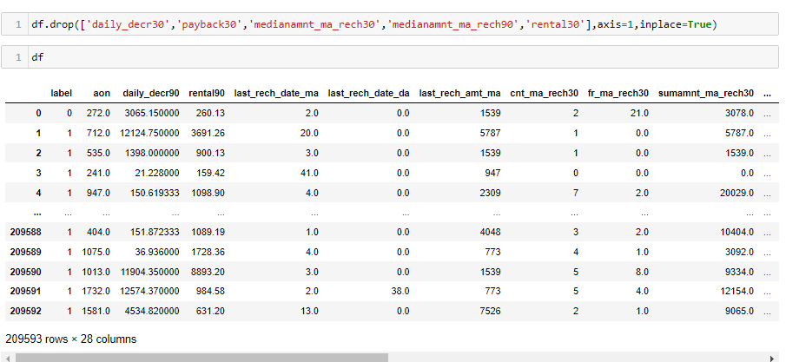
From the above heat map, we could remove the variables which are highly corelated with each other

Slide 9
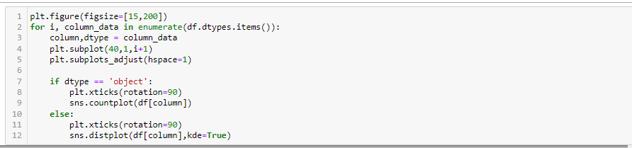
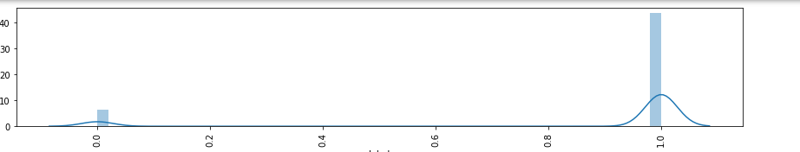
Visualisation:
We Analyze the variables using the countplot for categorical the variables and distplot for numerical variables
From the above Formula we can visualize all the numerical data and categorical data graphs

Slide 10
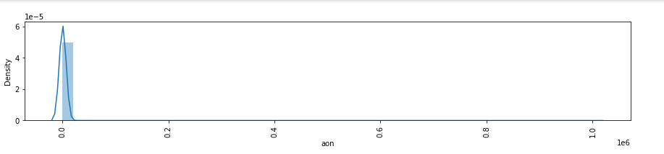
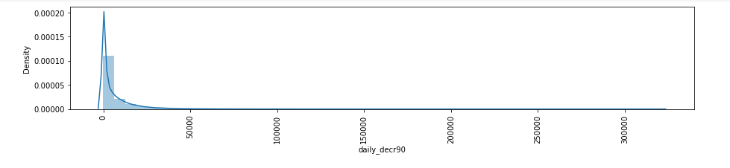
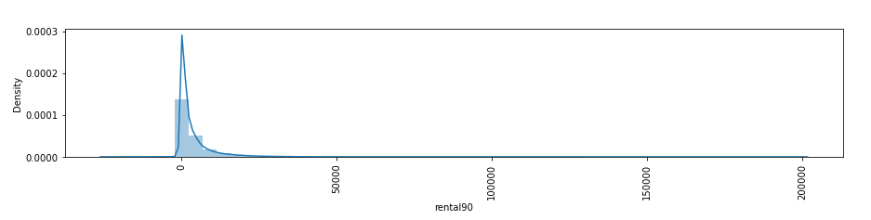
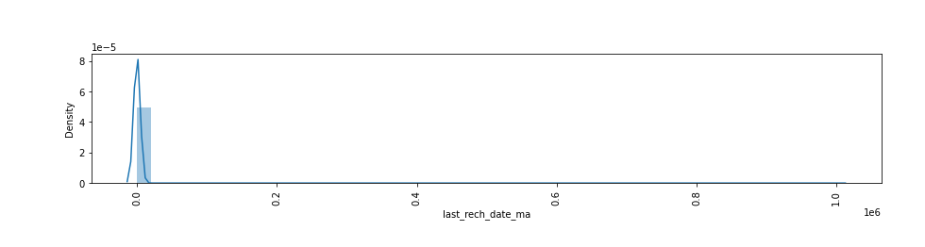
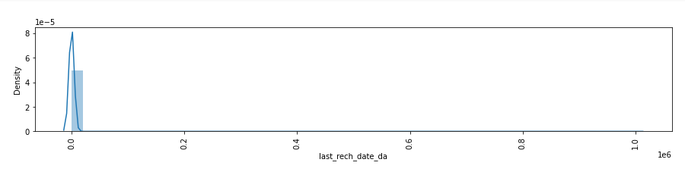
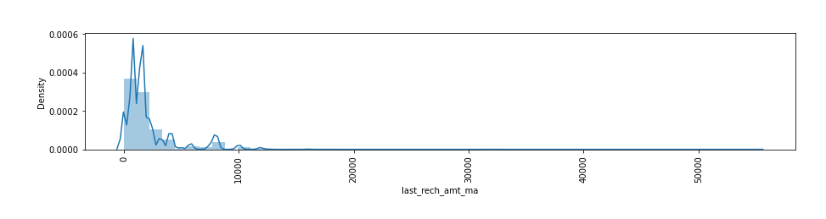
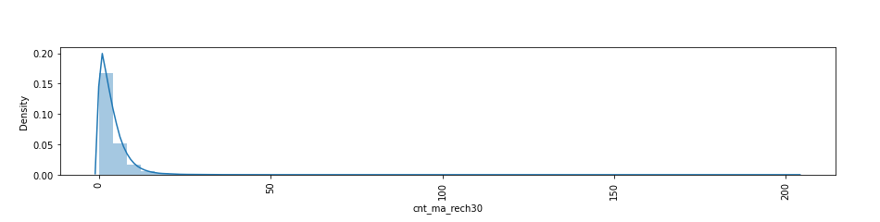

Slide 11
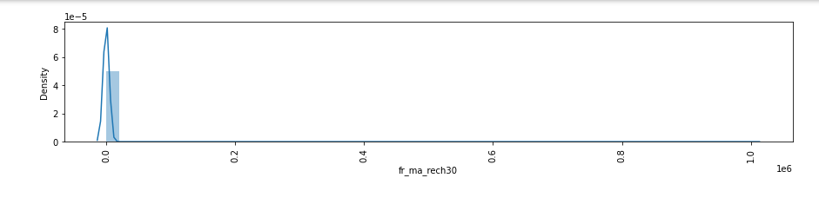
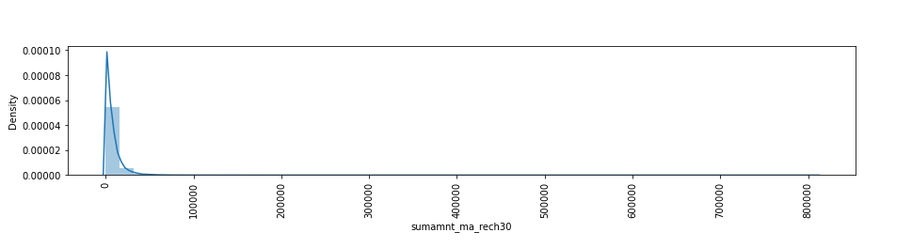
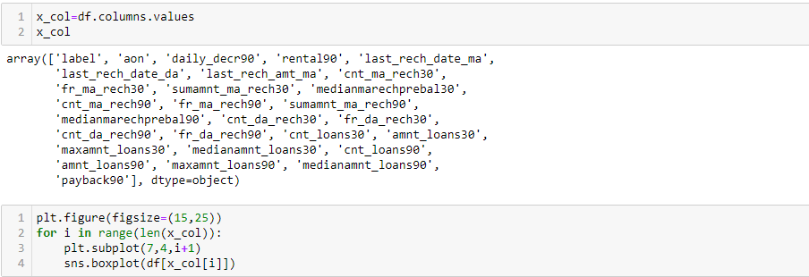
By Observing Above Graphs we understood our data is skewed like left skewed and right skewed.
Outliers:

Slide 12
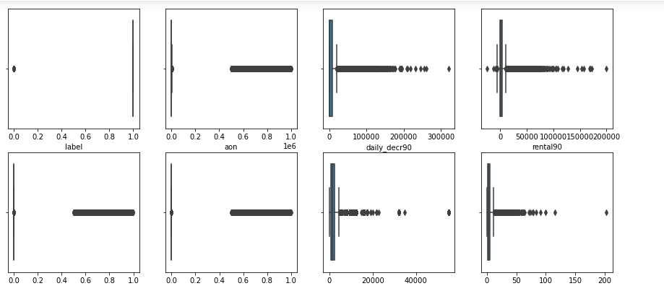
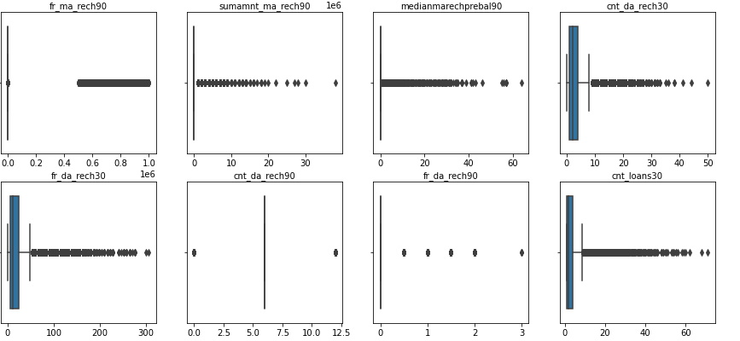
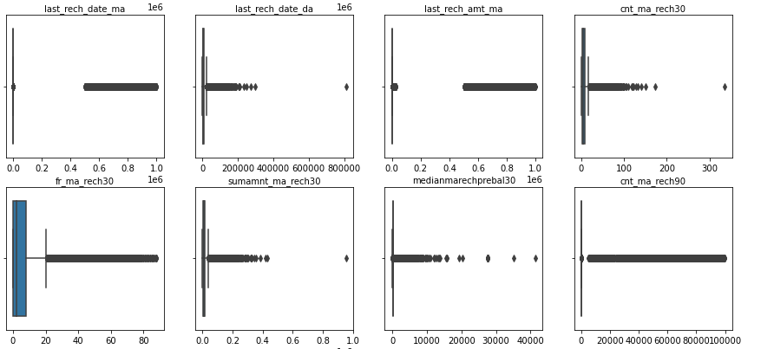
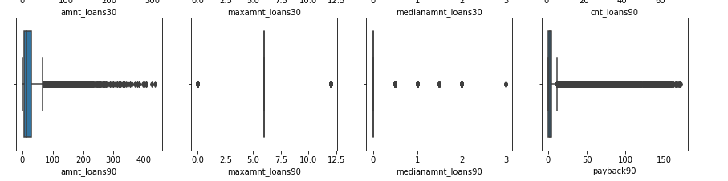

Slide 13
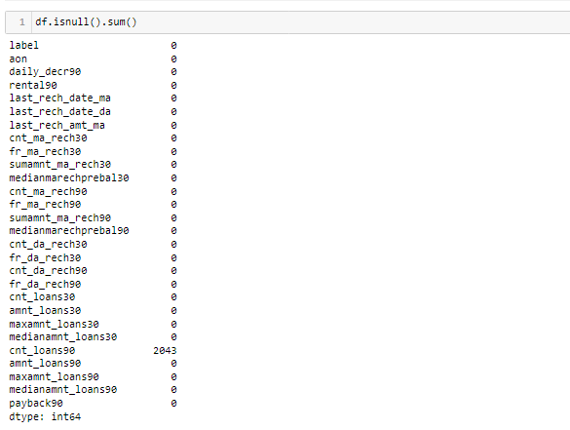
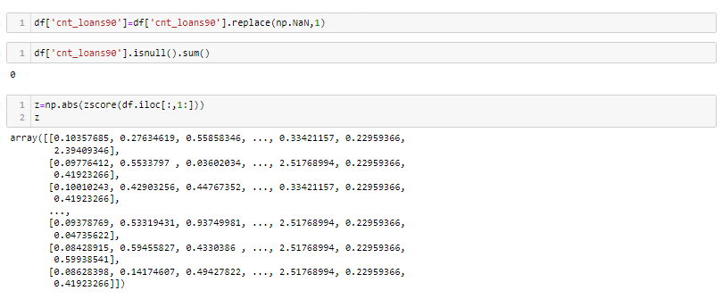
There are some null values in one of the column, so need to replace the values.

Slide 14
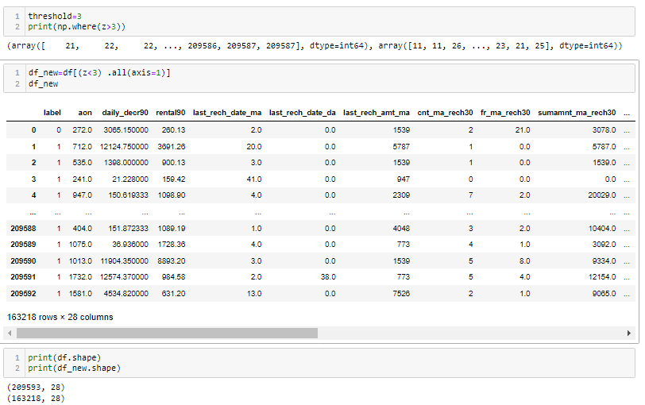

As per the new data almost 22% of the data is removed as outliers.

Slide 15
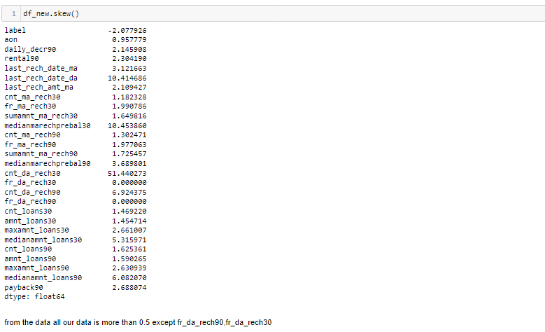
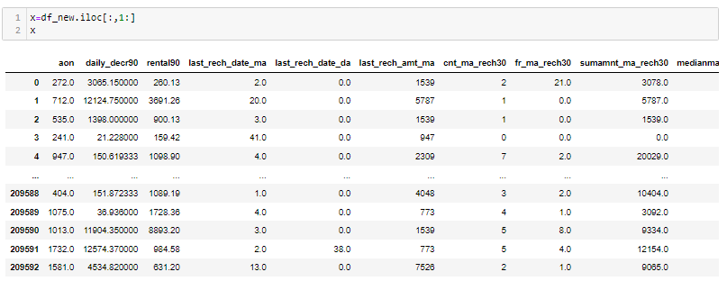
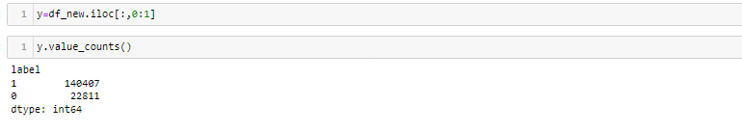
As per our dataset almost 28 columns are there so we need to use VIF or PCA Techniques to reduce the columns.
As our Dependent Variable is Im Balanced so we need to use smote technique,to make our model as accurate.

Slide 16
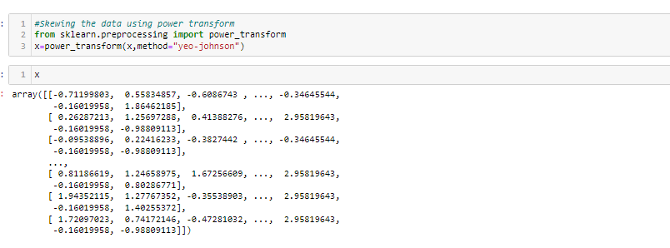
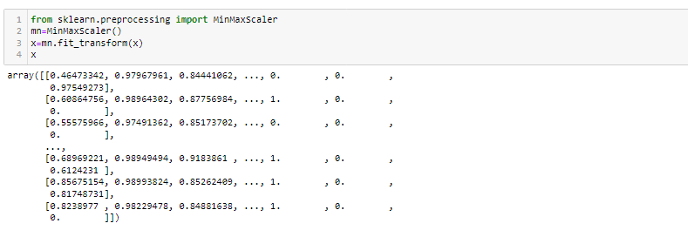
Skewness of Data:
As of our numeric data is skewed we need to do normalization before go for training and testing for that need to check the skewness of data if our data is Greater than 0.5% in both positive and negative sides ,then need to do power transformation and do scaling
Scaling are of two types:
1.Standard Scaler: Standard scalar standardizes features of the data set by scaling to unit variance and removing the mean (optionally) using column summary statistics on the samples in the training set.
MIN-MAX Scaler: MinMaxScaler. For each value in a feature, MinMaxScaler subtracts the minimum value in the feature and then divides by the range. The range is the difference between the original maximum and original minimum. MinMaxScaler preserves the shape of the original distribution.

Slide 17
Modelling :
We know that this is Classification problem so we use F1_Score , Confusion matrix, Precision and Recall as our eveluation matrix. We also see the cross validated score.
We also do feature scaling to scale down the data.
First we see the result without doing hyper-parameter tuning.
We also use several models as our evaluation model without using hyper-parameter tuning and see their result and after that we do hyper-parameter tuning and compare both the result that which one gives better F1_Score
Before modeling After splitting the Data, Do the PCA to reduce the columns

Slide 18
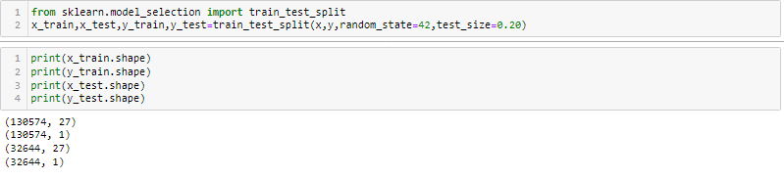
Principal Component Analysis(PCA):
Principal component analysis (PCA) is a technique for reducing the dimensionality of such datasets, increasing interpretability but at the same time minimizing information loss. It does so by creating new uncorrelated variables that successively maximize variance.
Large datasets are increasingly widespread in many disciplines. In order to interpret such datasets, methods are required to drastically reduce their dimensionality in an interpretable way, such that most of the information in the data is preserved. Many techniques have been developed for this purpose, but principal component analysis (PCA) is one of the oldest and most widely used. Its idea is simple—reduce the dimensionality of a dataset, while preserving as much ‘variability’ (i.e. statistical information) as possible. Although it is used, and has sometimes been reinvented, in many different disciplines it is, at heart, a statistical technique and hence much of its development has been by statisticians. This means that ‘preserving as much variability as possible’ translates into finding new variables that are linear functions of those in the original dataset, that successively maximize variance and that are uncorrelated with each other.

Slide 19
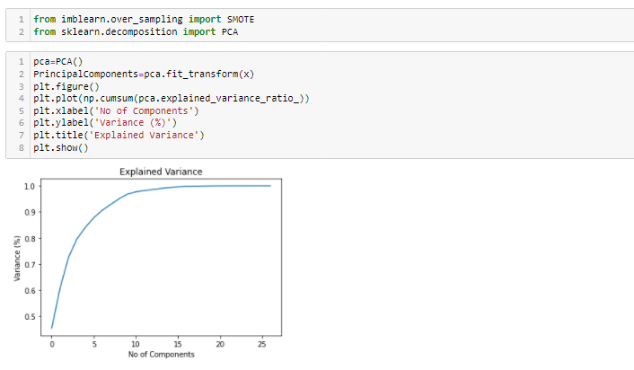
From the Graph, its clearly understands that instead of using 27 variables, we can use 12 to make the model is accurate.

Slide 20
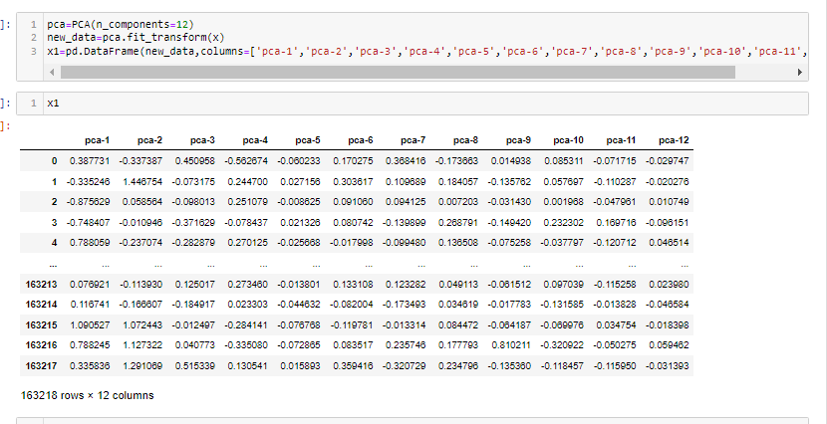
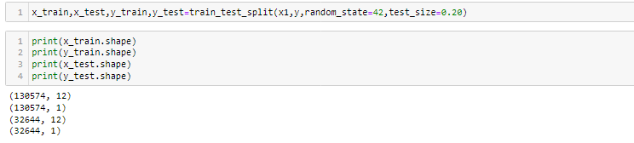
As we do splitting the data for training and testing the data then now we need to modeling
Try Different Models….
After Doing splitting we have to balanced our data.it can be by SMOTE or oversampling methods. Like Up Sampling, down sampling.
Up sampling: -This method used to modify the unequal data into the balanced data by increases the minor class or rare class. Advantage of this method is to no loss of information but from that model can be in overfitting.
Down Sampling: like the Up sampling its also balanced data but by reducing the size of the class which is high

Slide 21
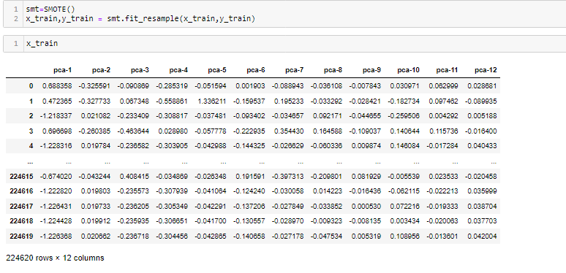
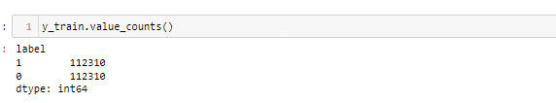
But if we balanced our data before train test split means we balanced from our whole data set or form x. it means at that time our test data is leak. We have to isolate our test data. Here you expose it.so our f1 or recall or precision will be good. so, our model will already know which is positive or negative. And I can also say because of that there is bias or model Overfitting.to prevent this We balanced our data

Slide 22
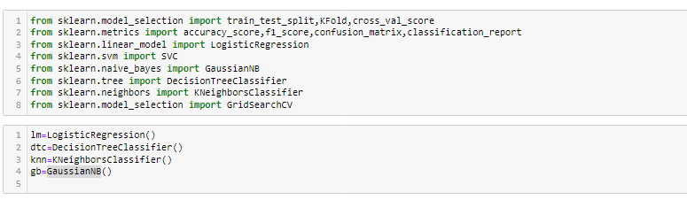
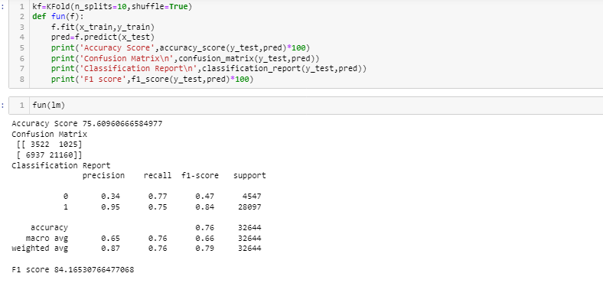
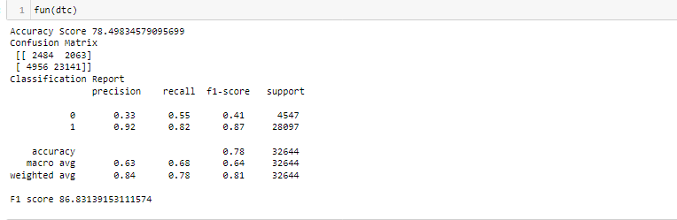
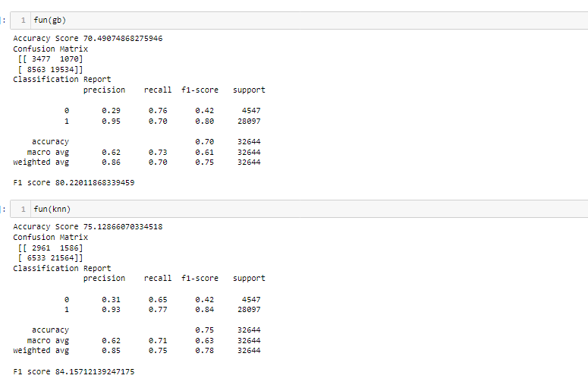

Slide 23
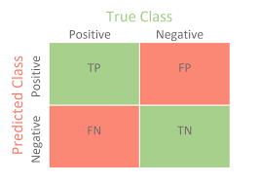
Here my GaussianNB Classifier is giving an accuracy score of 70.49% and F1-Score :80.22%.
Here my KNN Classifier is giving an accuracy score of 75.12% and F1-Score :84.15%.
Here my Decision Tree Classifier is giving an accuracy score of 78.49% and F1-Score :86.83%.
Here my Logistic Regression is giving an accuracy score of 75.6% and F1-Score :84%
Confusion Matrix: It is the table that is used to describe the performance of classification model on set of tests data.by using different parameters.
We get the best score in Random Forest Classifier as Accuracy score is 82.85%,And model predicts 3892 as True Positive,462 False Positive , 455 False Negative and 538 True Negative
Accuracy: it can be defined as the ratio of total number of correct classifications divided by total number of classifications.
Accuracy=(TP+TN)/(TP+FP+TN+FN)
Precision: It is measure of all the positive predictions how many of them actually positive. Precision=TP/(TP+FP)
F1-Score: It give the combine result of Recall and Precision
F1-score=2*(Precision*Recall)/ (Precision + Recall)

Slide 24
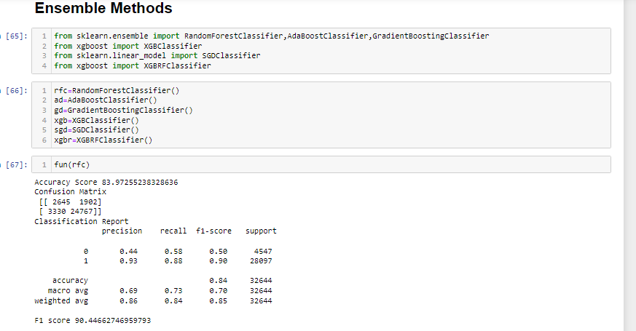
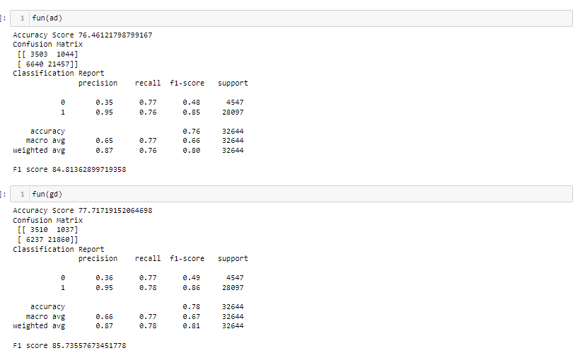
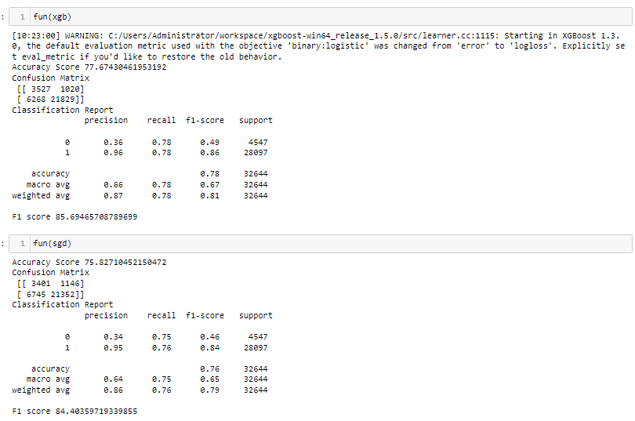

Slide 25
Here my Forest Classifier is giving an accuracy score of 83.97% and F1-Score :90.44%.
Here my ADA Booster Classifier is giving an accuracy score of 76.46% and F1-Score :84.81%.
Here my Gradient Classifier is giving an accuracy score of 77.71% and F1-Score :85.73%.
Here my XGB Booster Classifier is giving an accuracy score of 77.67% and F1-Score :85.69%.
Here my Strochastic Gradient Classifier is giving an accuracy score of 75.82% and F1-Score :84.40%.

Slide 26
Conclusion And Remarks: From this model we can predict the defaulters in micro finance and predicts how it affects with each variable.
We used different classifiers like Logistic Regression, Decision tree Classifiers and Ada boosting classifiers, KNN Classifier, Gradient Classifier, Random Forest Classifier. And also used the data Balanced process and also hyper parameter tunning for improving score.
We get good score in Random Classifier we got accuracy of 83.97% on training data,F1 score is 90% in random forest classifier. the model performance is excellent.

Slide 27

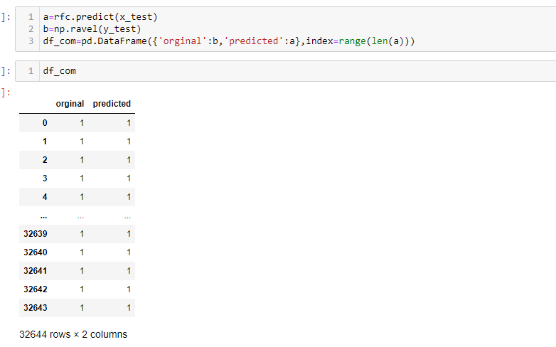
We further proceed to test the object that we saved using pickle, and create a data frame of predicted values –

Slide 28


